Slide 1
NODE.JS
(The Backend Of MERN Stack)
Lecture 45

Slide 2
Today’s Agenda
What Is JWT?
JWT Workflow
Structure Of JWT
Internals Of JWT
How Node Supports JWT ?
Exercises

Slide 3
What is jwt ?
JWT or JSON Web Tokens (JWT) is a compact and self-contained technique for securely transferring data between parties as a JSON object.
JWT is used for stateless authentication mechanism by storing information on the client-side instead of storing sessions on the server.

Slide 4
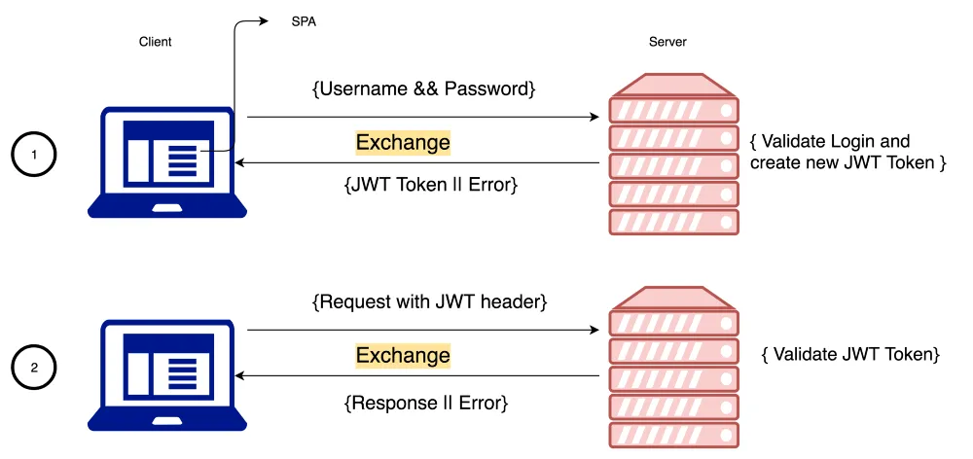
Jwt workflow

Slide 5
Jwt workflow
A client makes the API call and sends the user information such as username and password to the webserver.
On successful authentication the webserver generates a string-based token and returns to the client system.

Slide 6
Jwt workflow
The client can store this token in the browser’s secondary memory storage.
On next API call the client submits the JWT token along with the request .
The server then verifies the token , and after successful verification, the server returns the response to the client.

Slide 7
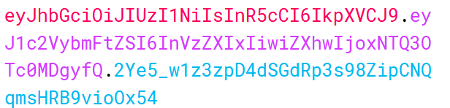
Structure of jwt
A sample JSON Web Token
As we can see in the image, there are three sections of a JWT, each separated with a dot and they are:
Header
Payload
Signature

Slide 8
Structure of jwt
The first part is the header (eyJhbGciOiJIUzI1NiIsInR5cCI6IkpXVCJ9) represented in base-64 encoding.
The header specifies information like the algorithm used to generate the signature (the third part).
This part is pretty standard and is the same for any JWT using the same algorithm.

Slide 9
Structure of jwt
The second part is the payload (eyJ1c2VybmFtZSI6InVzZXIxIiwiZXhwIjoxNTQ3OTc0MDgyfQ), which contains application specific information.
In our case, this is the username as well as information about the expiry of the token.
Like header , the payload also is represented in base-64 encoding.

Slide 10
Structure of jwt
The third part is the signature (2Ye5_w1z3zpD4dSGdRp3s98ZipCNQqmsHRB9vioOx54).
It is generated by combining and hashing the first two parts along with a secret key.

Slide 11
Important point
We must remember that the header and payload are not encrypted .
They are just base64 encoded.
This means that anyone can decode them using a base64 decoder.

Slide 12

Important point
For example, if we decode the header to plain text, we will see the below content:

Slide 13
Important point
Similarly, the contents of the payload are:

Slide 14
How is jwt secure then ?
So if the header and payload of a JWT can be accessed by anyone, what actually makes a JWT secure?
The answer lies in how the third portion (the signature) is generated.

Slide 15
Working of jwt
Consider an application that wants to issue a JWT to a user (for example, user1) that has successfully signed in.
Making the header and payload are pretty straightforward:
The header is fixed for our use case, and the payload JSON object is formed by setting the user ID and the expiry time in unix milliseconds.

Slide 16
Working of jwt
The application issuing the token will also have a key, which is a secret value, and known only to the application itself.
The base64 representations of the header and payload are then combined with the secret key and then passed through a hashing algorithm (in this case its HS256, as mentioned in the header)

Slide 17
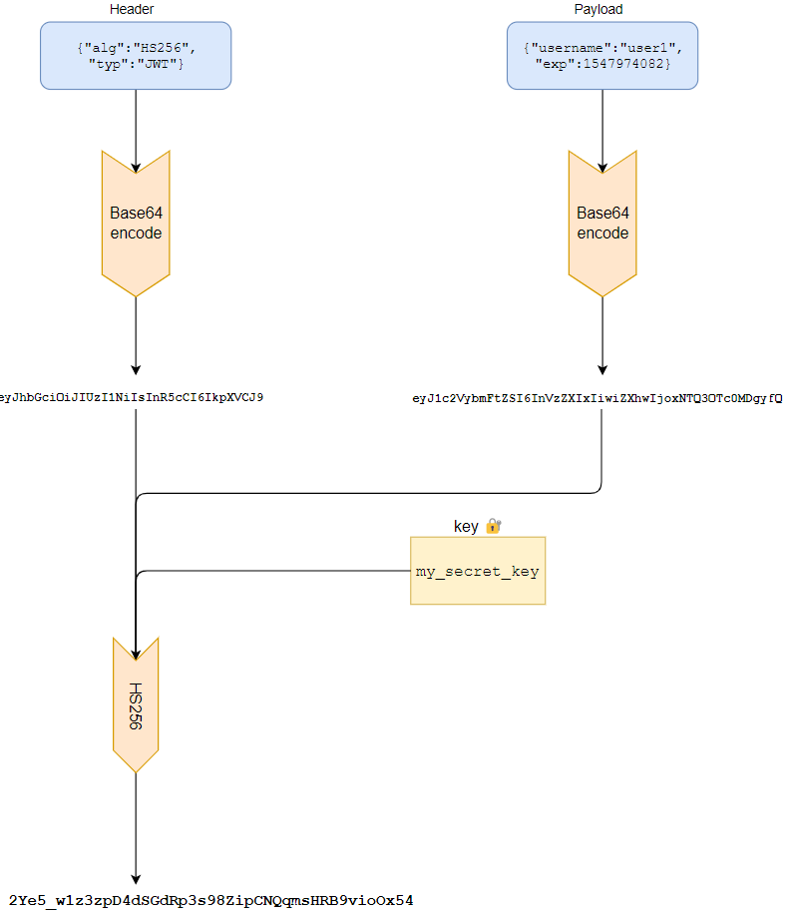
Working of jwt

Slide 18
Working of jwt
The important thing to note is that it is one way, which means that we cannot reverse the algorithm and obtain the components that went into making the signature - so our secret key remains secret.

Slide 19
Verifying a jwt
To verify a JWT, the server generates the signature once again using the header and payload from the incoming JWT, and its secret key.
If the newly generated signature matches the one on the JWT, then the JWT is considered valid.

Slide 20
Verifying a jwt
In this way, the JWT acts as a way to authorize users in a secure manner, without actually storing any information (besides the key) on the issuing server.

Slide 21
How node supports jwt ?
In Node we have an npm package called jsonwebtoken which we need to install to use JWT in our app.
npm install jsonwebtoken
Then we need to import it in our app and this will give us an object.
const jwt=require(“jsonwebtoken”);

Slide 22
How node supports jwt ?
The jwt object provides us 2 methods called :
sign()
verify()
These methods are the core of JWT and help us in generating and verifying the JWT token.

Slide 23
The sign() method
Syntax:
sign(payload, secretKey,options)
Explanation of arguments:
payload: It could be an object or string representing valid JSON holding any data we want to store in the token.
secretKey: It is a string used for signing the token.
options : A JSON object having a key called expiresIn representing the expire time in seconds or a time span like 60, "2 days", "10h", "7d".

Slide 24
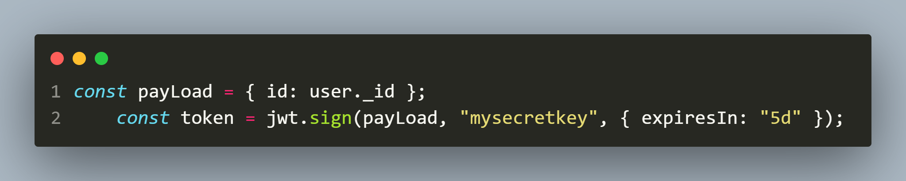
Sample call
In the above code we are setting user._id as the payload , “mysecretkey” as the secret key and 5 days as the expiry time.
The return value will be a JSON Web Token containing the above information as well as the generated signature.

Slide 25
The verify() method
Syntax:
verify(token, secretKey)
Explanation of arguments:
token: It is the json web token we received from the client.
secretKey: It is a string used for signing the token.

Slide 26
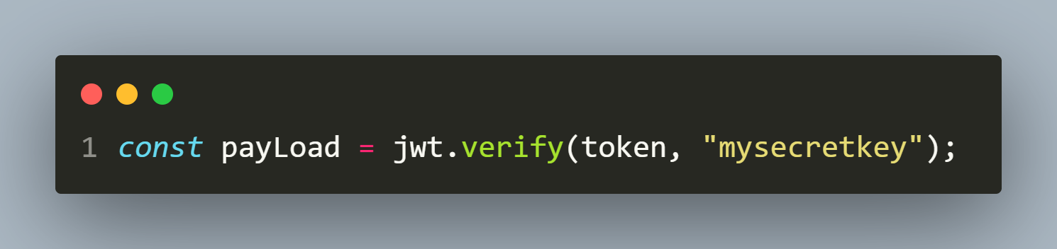
Sample call
In the above code we are passing the jwt token we received from client as the first argument and “mysecretkey” as the secret key
The return value will be the actual payload we passed to sign() or else we might get an exception called JsonWebTokenError if the token or key is invalid.

Slide 27
Exercise 94
Develop a RESTFul API for Register-Login-View application by making use of JWT having 3 features:
Feature 1:
It should register a new user in the database through POST request .
The credentials are: name, email and password and the validation needed is:
All three values must be present.
Minimum length of each should be 5.
Maximum length of name and email must be 50 and for password it must be 1024.
Email must be unique and valid.
In case of any exception/problem during query processing return appropriate response code with message.

Slide 28
Exercise 94
Feature 2:
Define a POST route for login request which will contain email and password.
Validate whether email and passwords are present and in valid format or not.
If not then return the error message.
Otherwise search the database for the matching credentials.
If not found then return the message “Invalid userid/password”
If matched then return a JWT.

Slide 29
Exercise 94
Feature 3:
Define a GET route for getting email id and username of every user in the database.
But this api call should only work if the user is logged in and has a valid JWT token.
If not then return the appropriate error message.

Slide 30
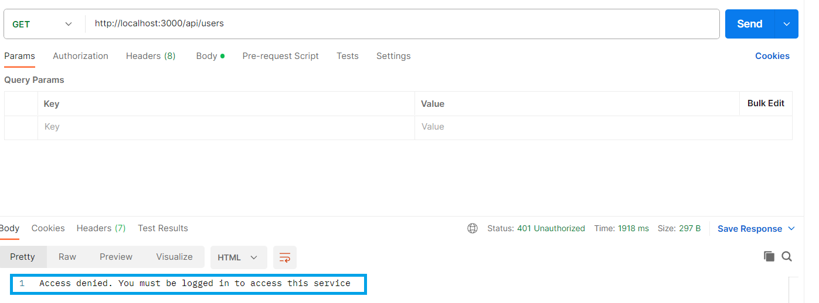
Desired output
Trying to obtain all user details without logging in

Slide 31
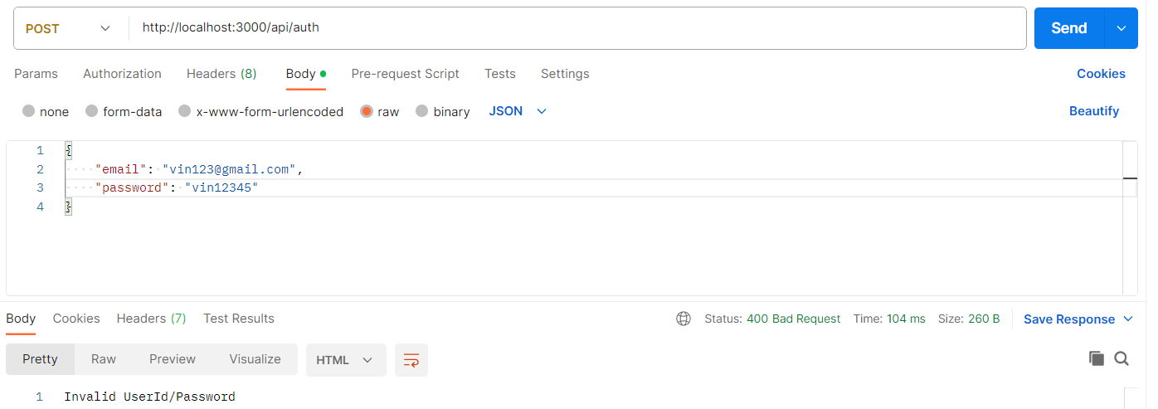
Desired output
Logging in with wrong credentials

Slide 32
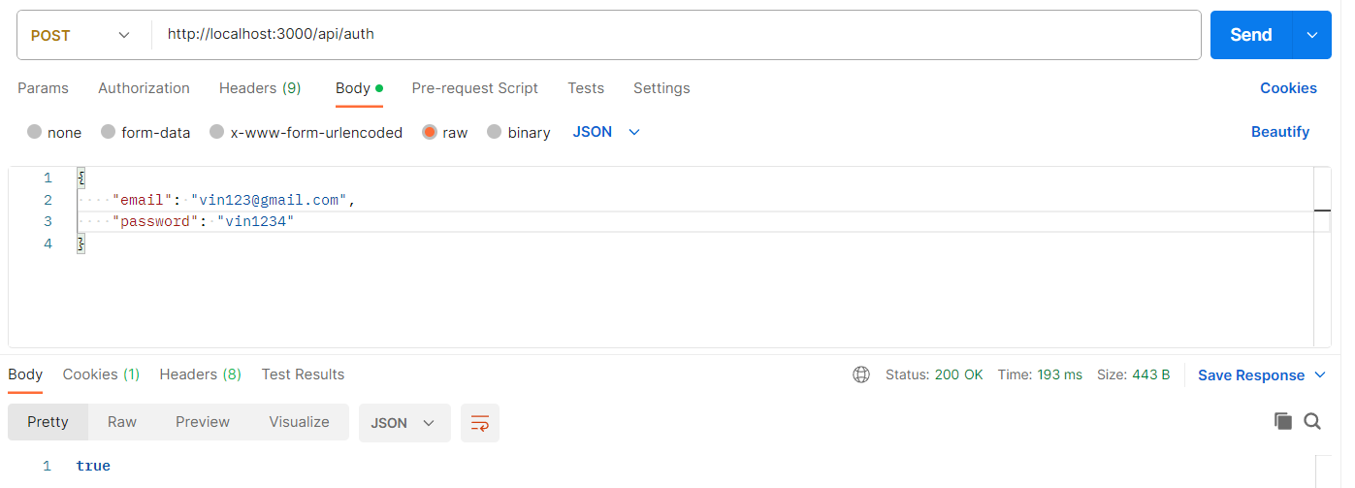
Desired output
Logging in with correct credentials

Slide 33
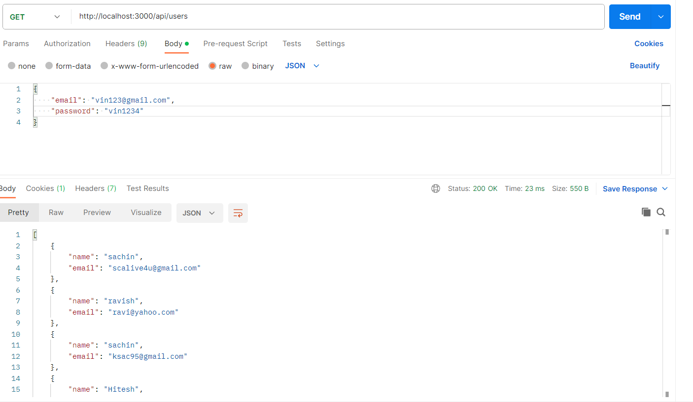
Desired output
Trying to obtain all user details after logging in

Slide 34
Dependencies needed
The application will require following 6 npm packages:
bcrypt
cookie-parser
express
joi
jsonwebtoken
mongoose

Slide 35
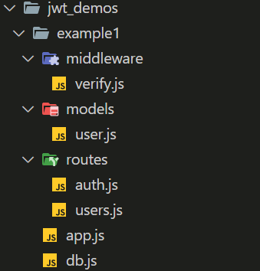
Application structure

Slide 36
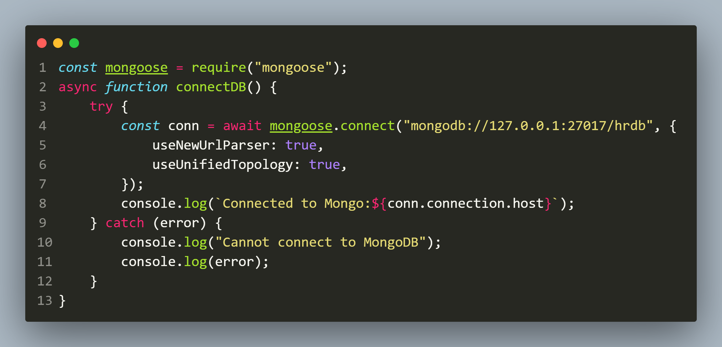
The db.js FILE

Slide 37
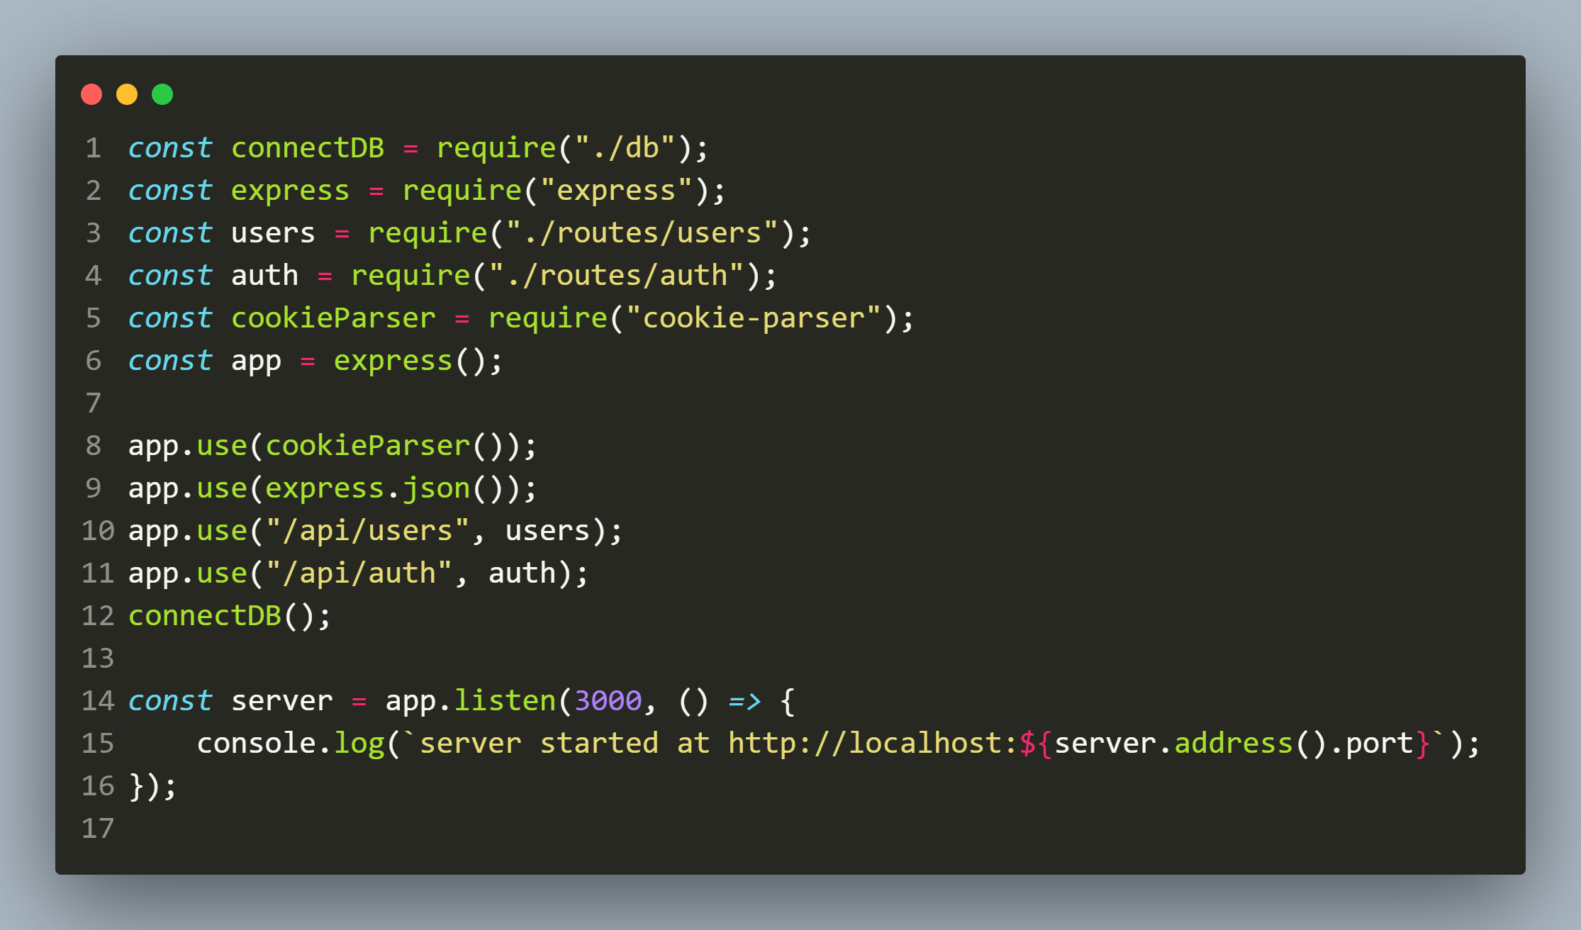
The app.js FILE

Slide 38
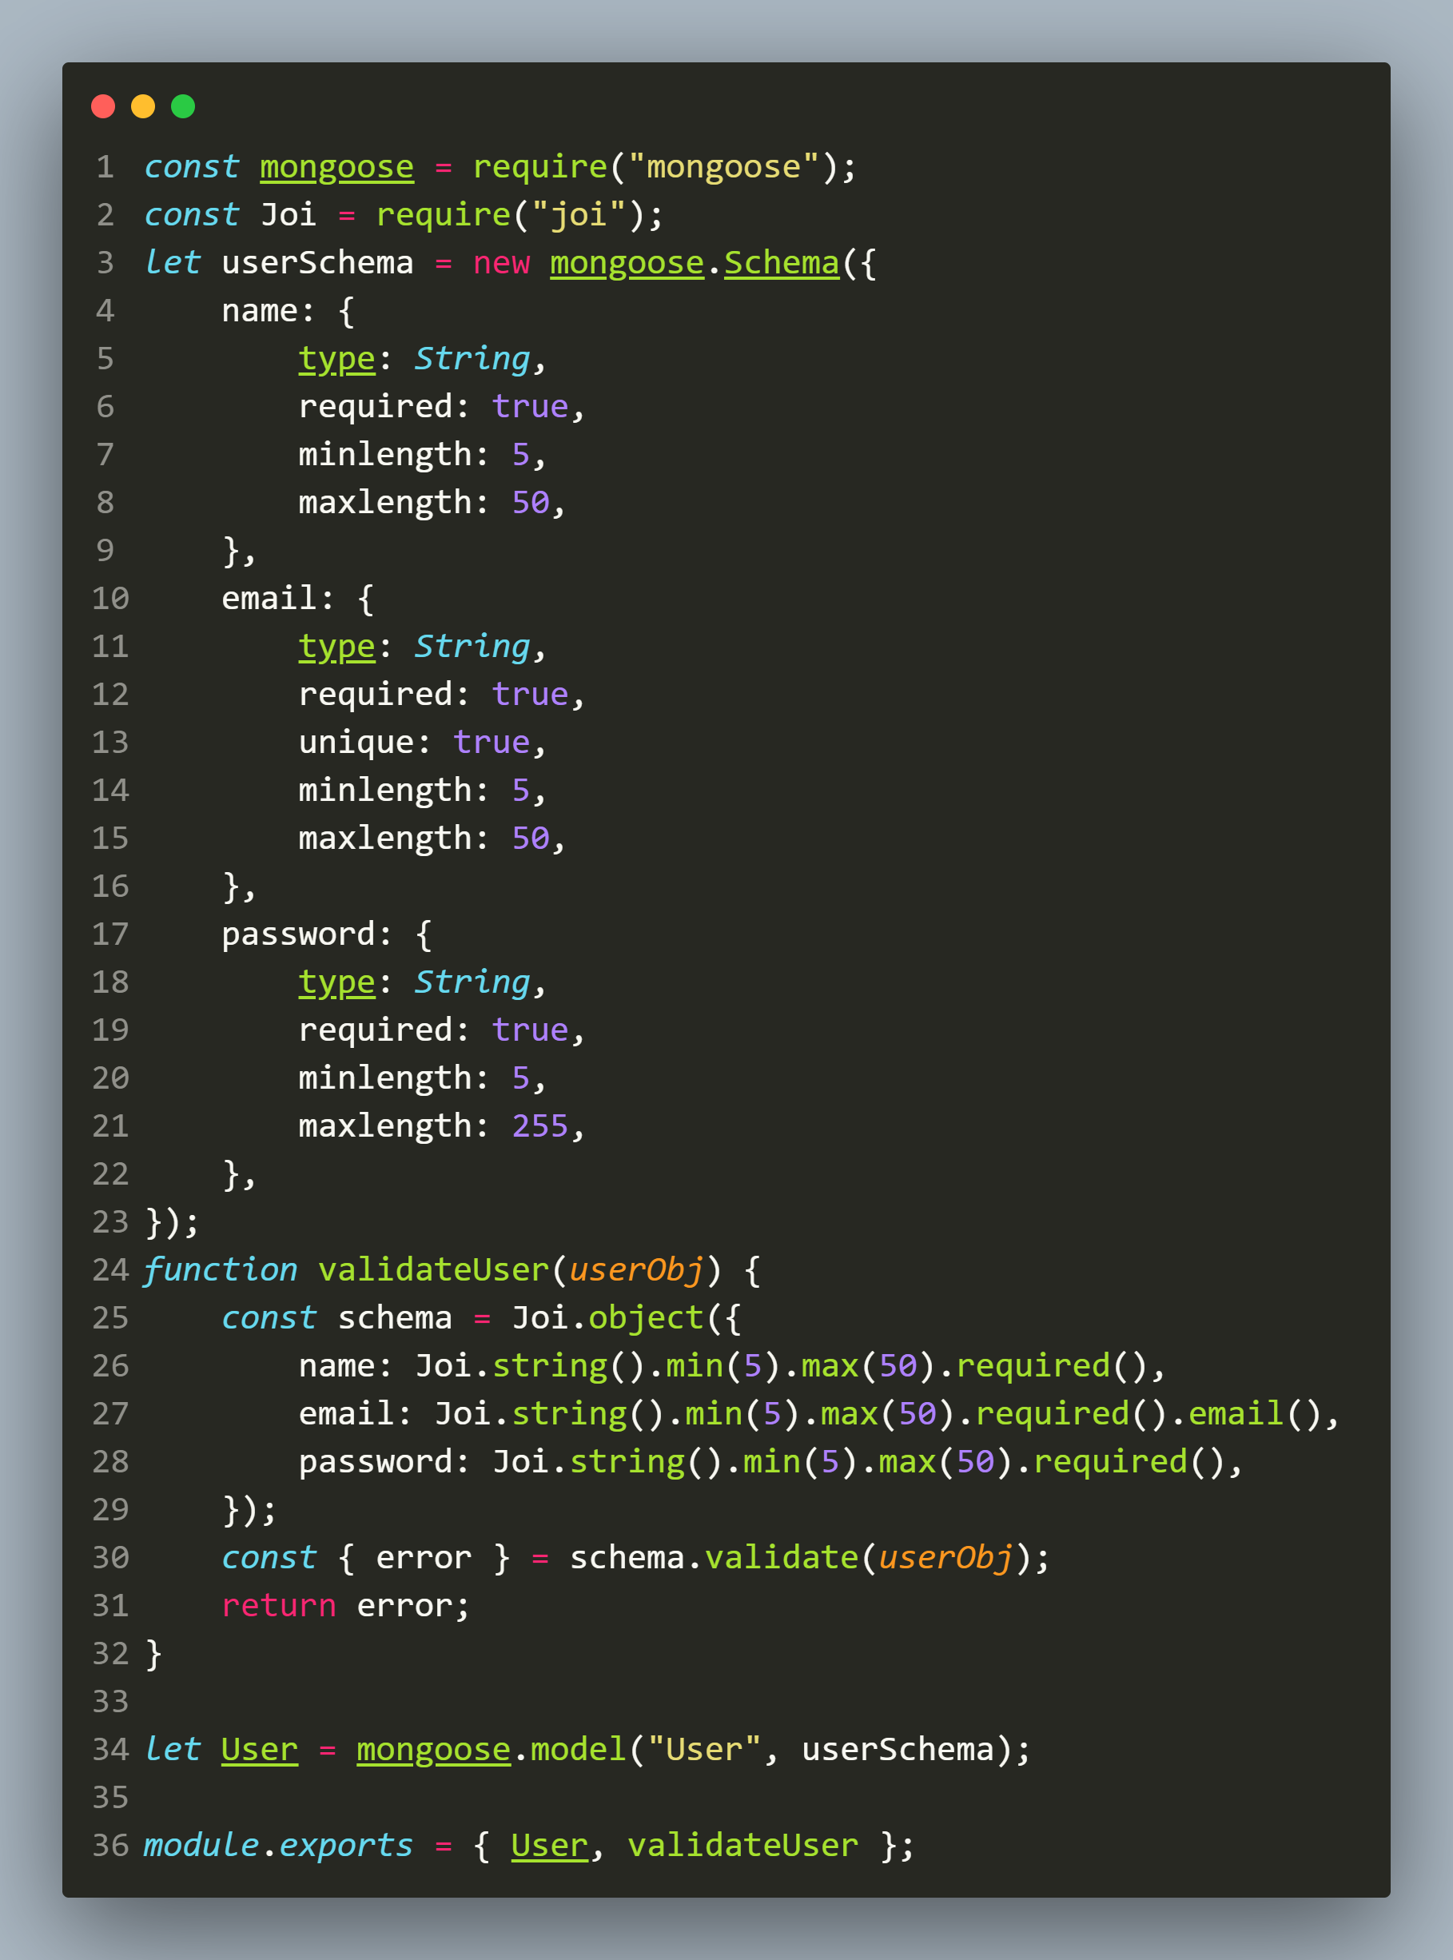
The models/user.js FILE

Slide 39
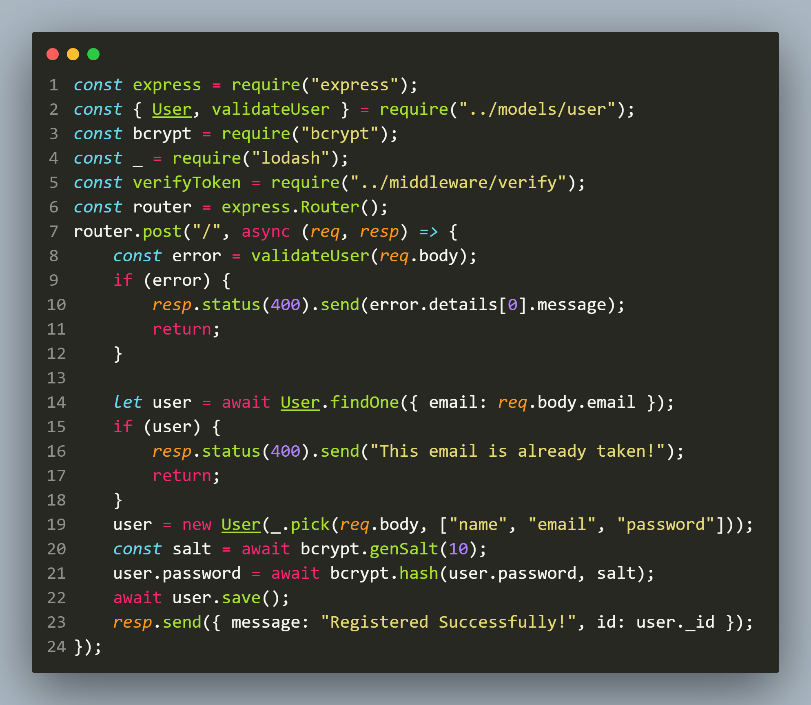
The routes/users.js FILE (only registration part)

Slide 40
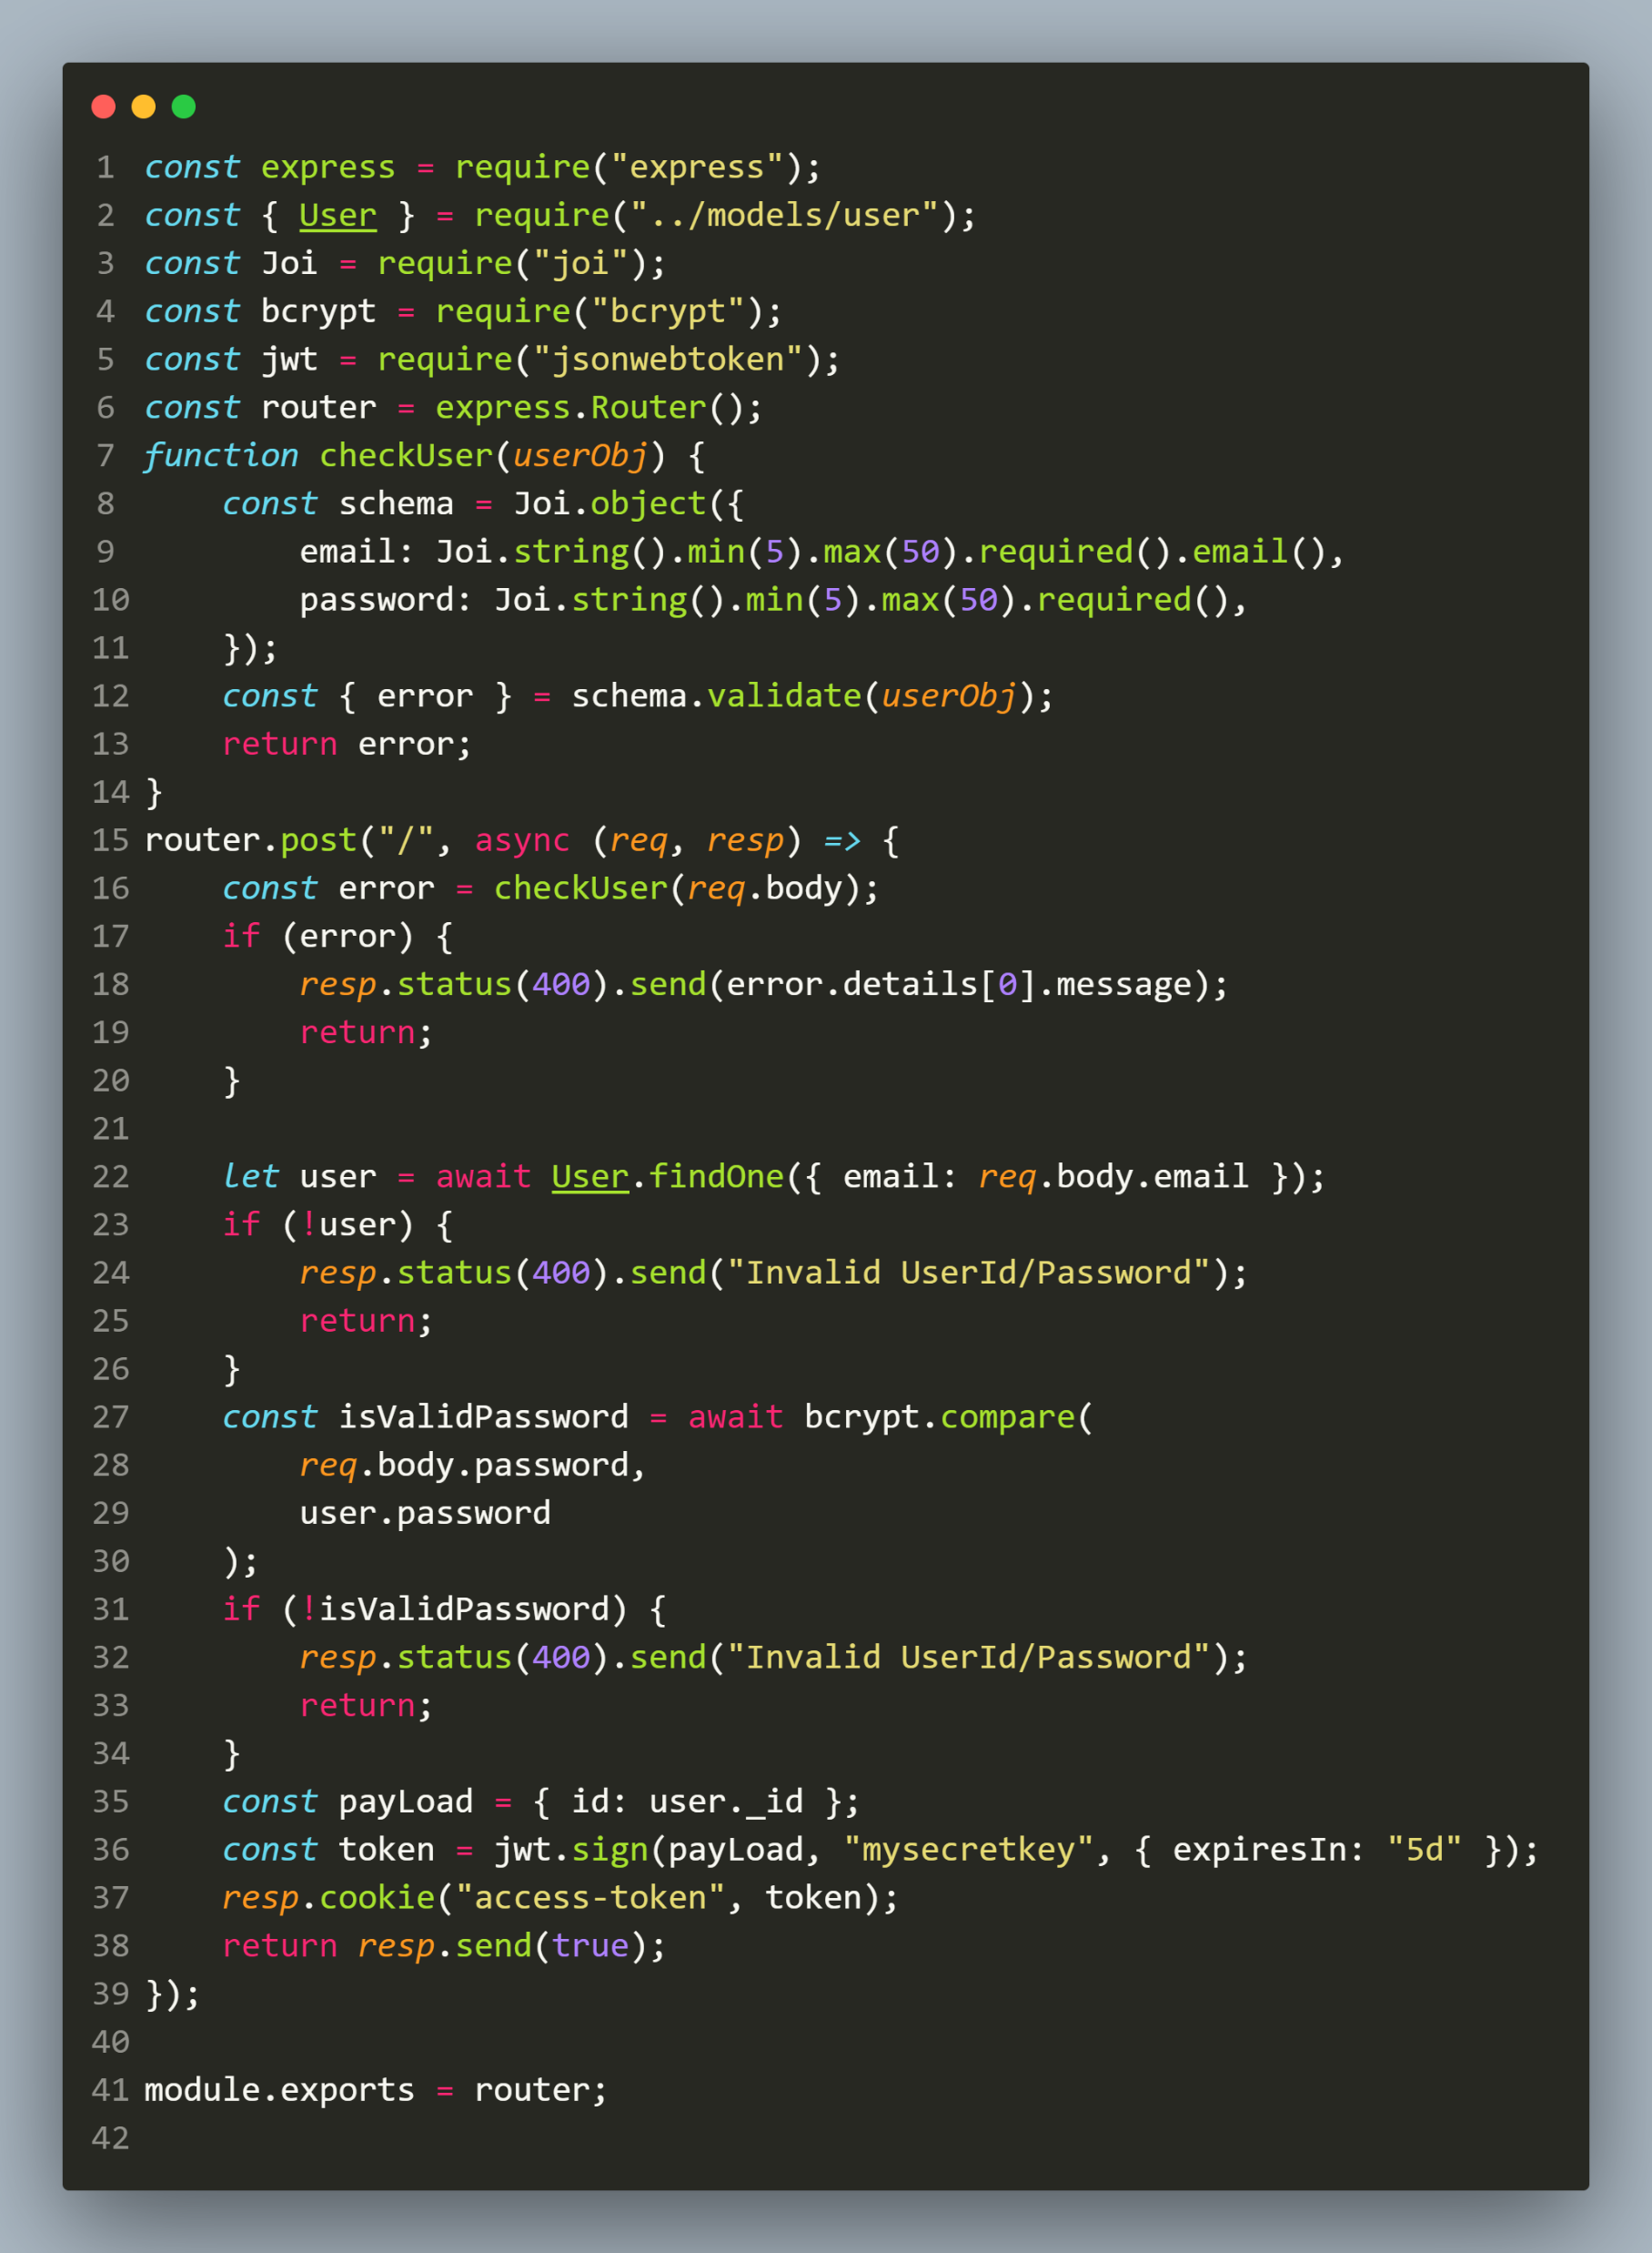
The routes/auth.js FILE (login part)

Slide 41
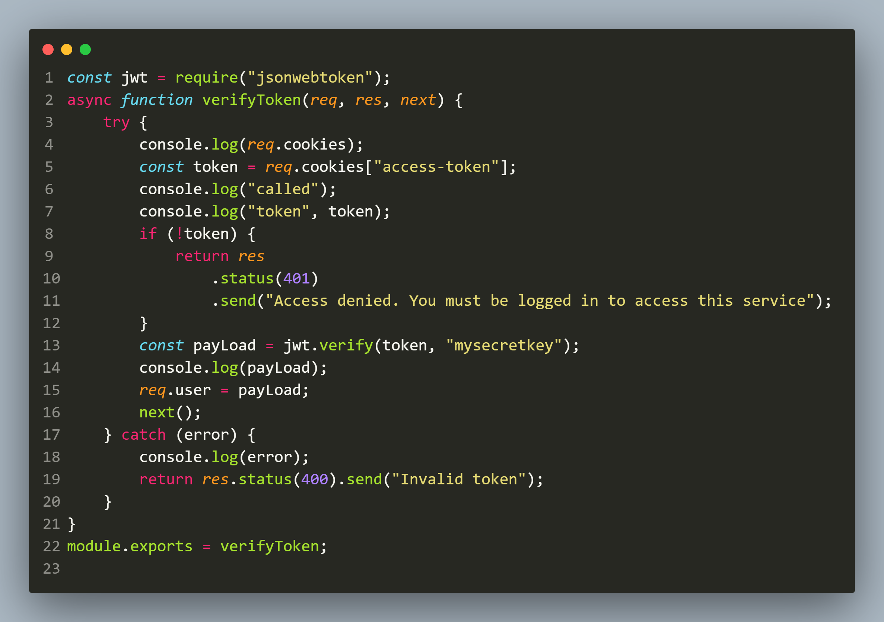
The middleware/verify.js FILE

Slide 42
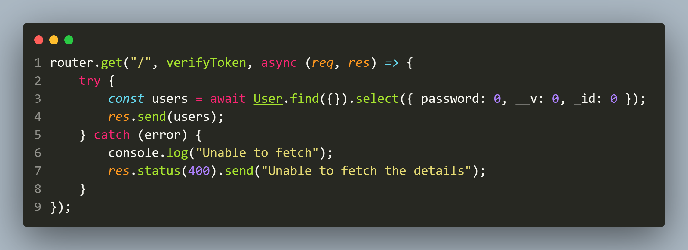
The routes/users.js FILE (accessing all users through GET route)

Slide 43
Exercise 95
Develop a application for Register-Login-Profile-View by making use of JWT.
The application must allow the user to:
Register
Login
View Profile
As expected the view-profile page should only open when the user is logged in.

Slide 44
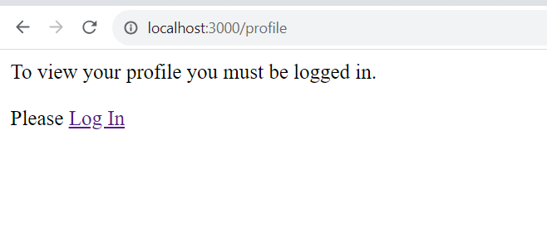
Desired output
Trying to visit profile page without logging in

Slide 45
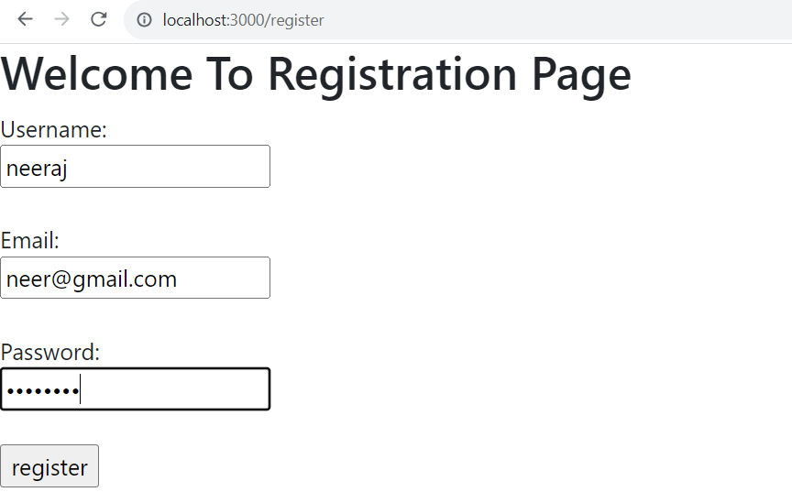
Desired output
Registering as new user

Slide 46
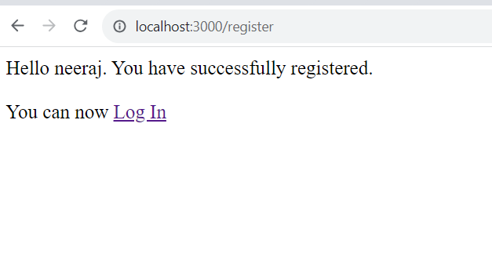
Desired output
Registering as new user

Slide 47
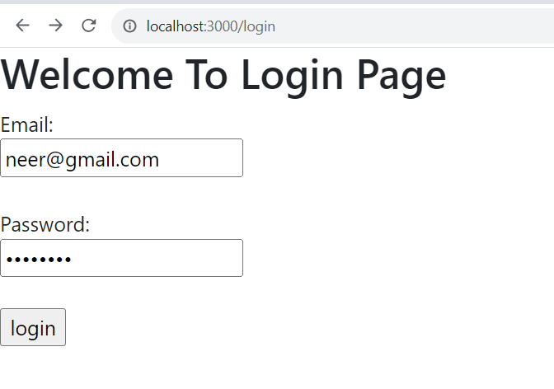
Desired output
Logging In

Slide 48
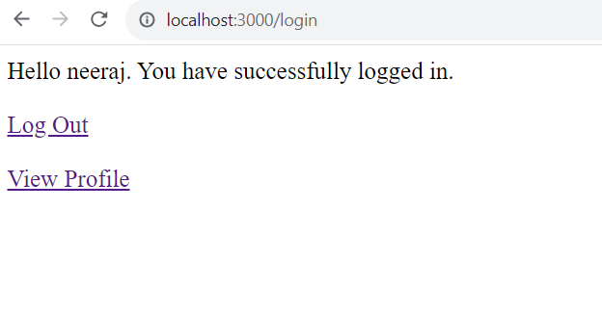
Desired output
After Logging In

Slide 49
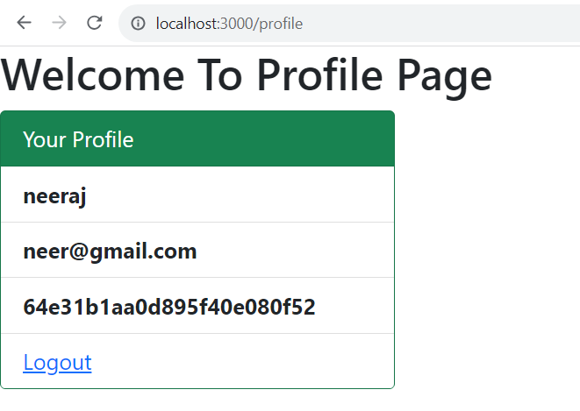
Desired output
After clicking on View Profile

Slide 50
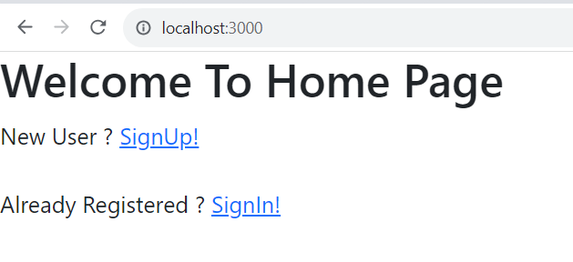
Desired output
After clicking on logout

